Slide 1

SpaceDodge Game
By Karim Mahmoud

Slide 2
Game Objectives
The game, the objective is to control the spaceship (player) using the left and right arrow keys, dodging falling stars.
The longer you survive without colliding with a star, the higher your score becomes. Different levels have different score goals for winning the game.

Slide 3
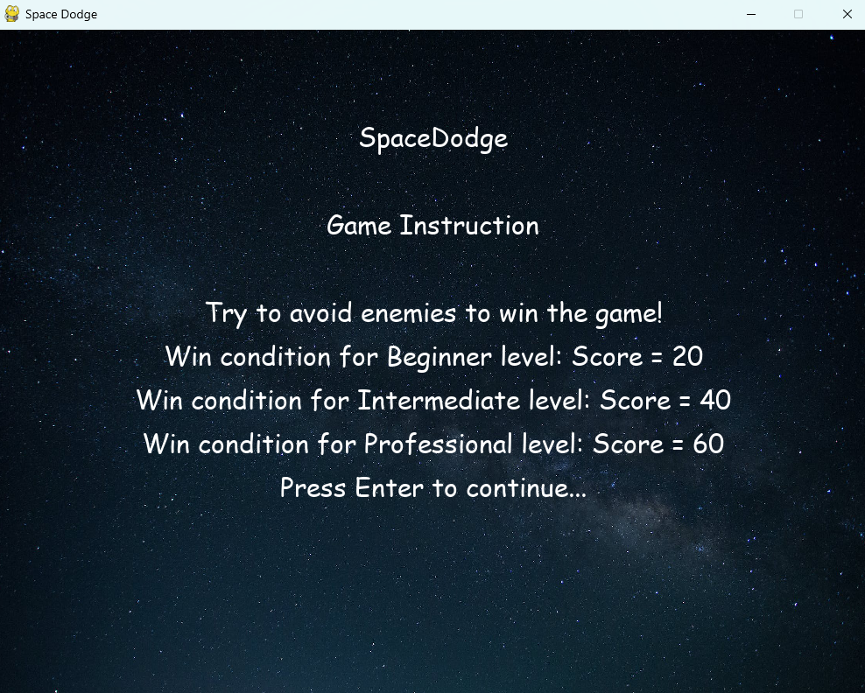
Game Instructions

Slide 4
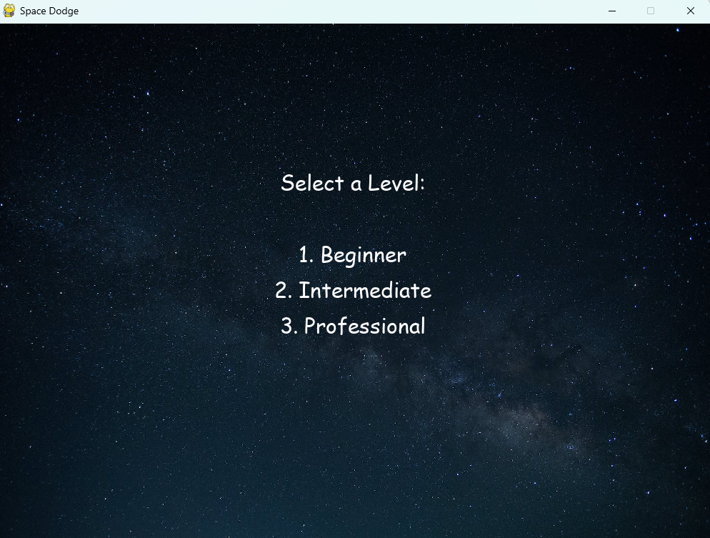
Select a level

Slide 5
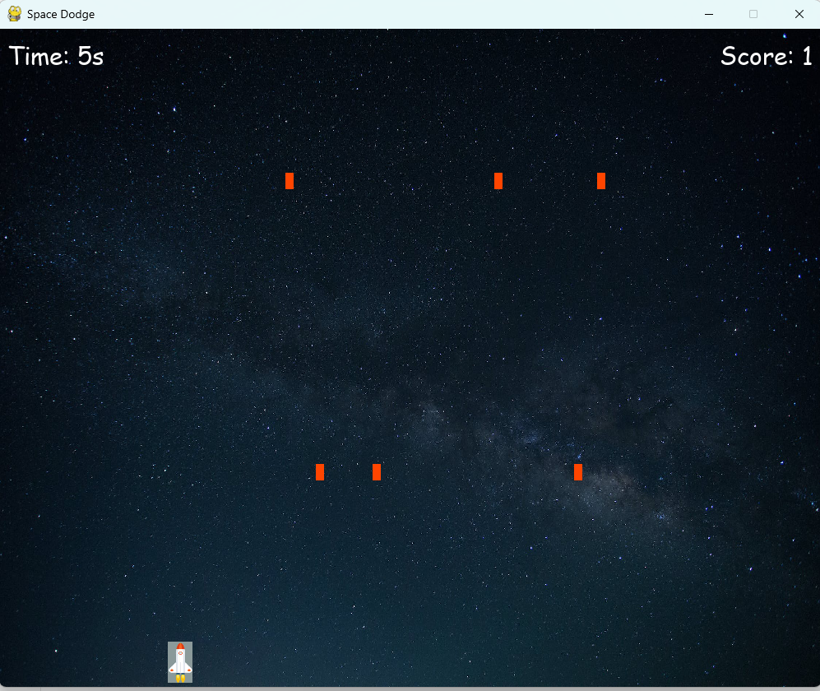
Game view

Slide 6
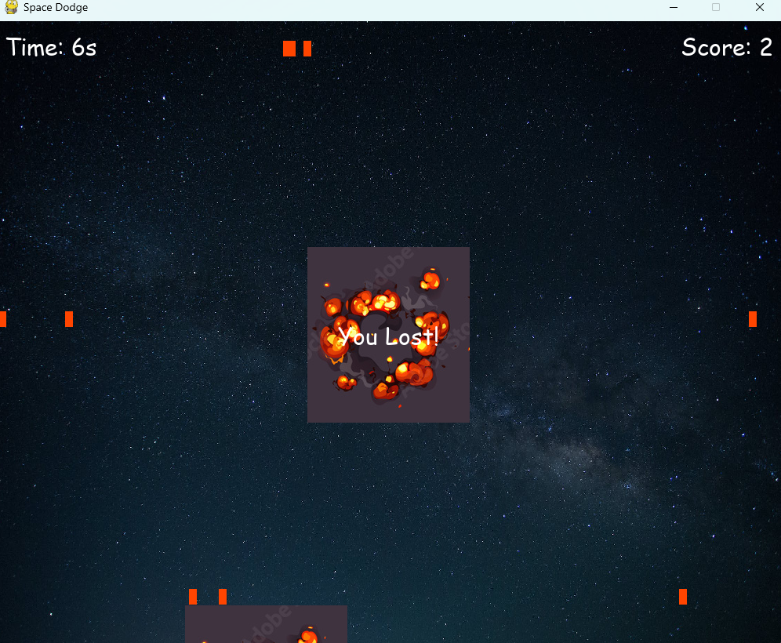
Lost message

Slide 7
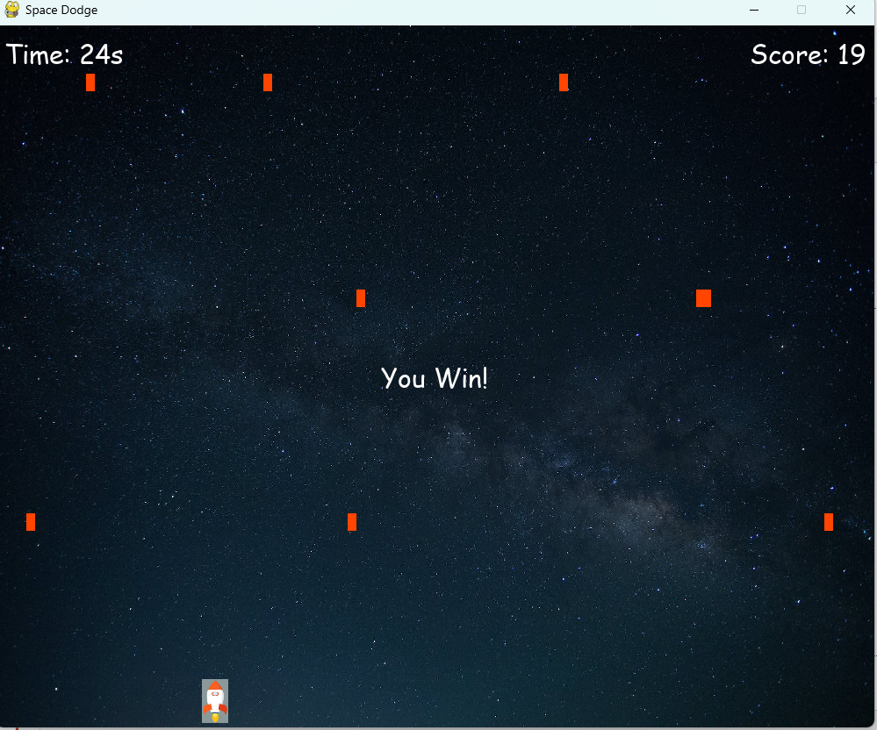
Win message

Slide 8
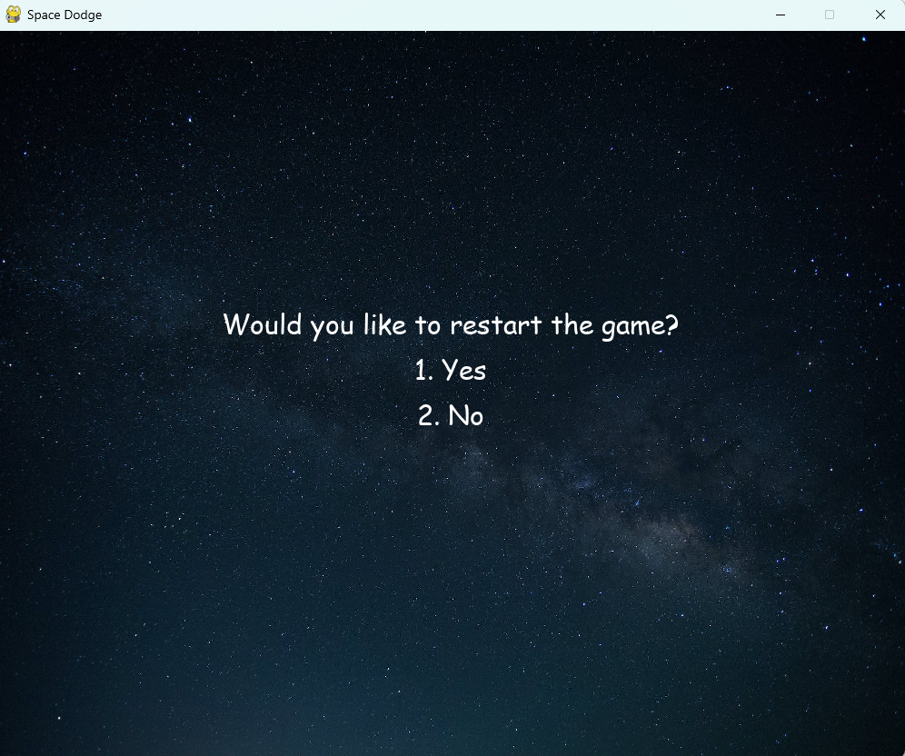
Restart the game

Slide 9
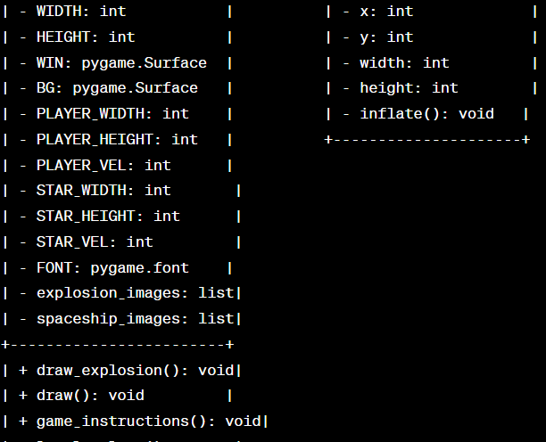
UML diagram

Slide 10

Thanks

